Slide 1
iPhone Programming Introduction
TMA Training Center (TTC)
Course | iPhone application development
Trainer | Son Nguyen
Designed by | TMA Mobile Solutions (TMS)
Last updated | 12 May 2011

Slide 2
Document Revision History
Date | Version | Description | Revised by
12 May 2011 | 1.0 | First version | Son Nguyen
Notes:
If your document based on this template is a document that is required to control the version, you must keep this slide and fill information related to version control and fill in the fields : Owner, Reviewers, Approver, Issue date, Issue status, Document location (menu File -> Properties -> tab Custom)

Slide 3
This section objectives
Understanding about :
  Mobile Programming
  Building an iPhone application
  MAC OS
  iPhone OS

Slide 4
Content
  Mobile Programming
  iPhone App Development Guide
  MAC OS
  iPhone OS

Slide 5
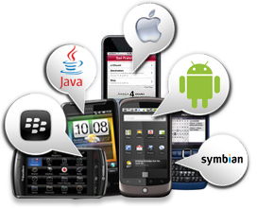
Mobile Programming
Create application software for small low-power handheld devices
These applications are either pre-installed on phones during manufacture, or downloaded by customers from various mobile software distribution platforms

Slide 6
Mobile Development Paradigm
Important to know the specs of the hardware you are designing
To maximize efficiency, purpose, performance…
Limited memory and Internet bandwidth
Limited Battery Life
Limited Screen real estate
Ease of Use
‘On the go’ vs sitting down on a desktop

Slide 7
Why iPhone?
The device that revolutionized the mobile market
The App Store!
Leading other companies to follow Apple’s model
  RIM – Blackberry App World
  http://appworld.blackberry.com/webstore/
  Microsoft –Windows Phone Marketplace
  http://marketplace.windowsphone.com/Default.aspx
  Nokia –Ovi Store
  http://store.ovi.com/
  Samsung – Samsung Apps
  http://www.samsungapps.com/
  and more…

Slide 8
Guide to App Development
Go to http://developer.apple.com/iphone/index.action
  Getting started articles and videos
  Downloads
  Primers to frameworks and Objective C
Download iPhone SDK (you will need Mac OSX 10.6.5 or higher)
  Download iPhone SDK 4.0
Learn and apply knowledge from this course and recommended reading
  Have fun and experiment!
Try running a few example applications by downloading Sample Code and trying them on the iPhone simulator
Become an Apple Developer for $99 to test on iPhone and deliver to App Store
  http://developer.apple.com/programs/iphone

Slide 9
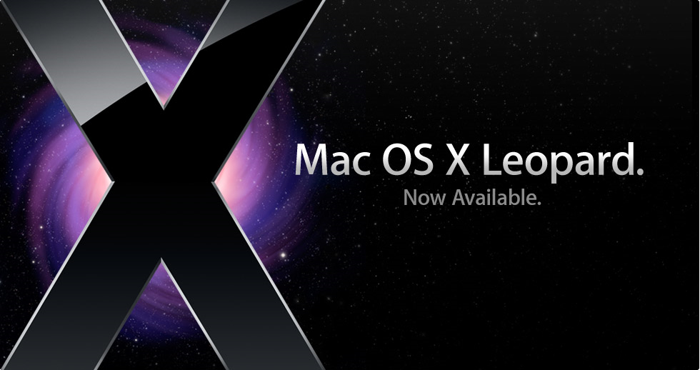
MAC OS Demo

Slide 10
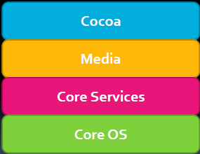
The Mac OS
•The Mac OS X consists of four frameworks

Slide 11
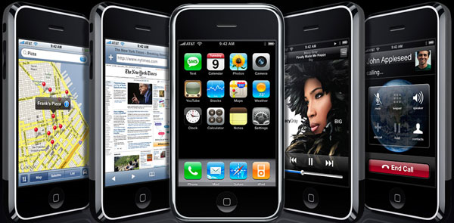
iPhone OS Demo

Slide 12
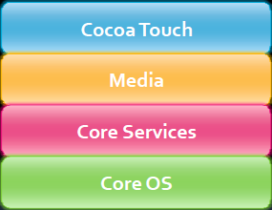
The iPhone OS
The iPhoneOS is a modified version of the Mac OS

Slide 13

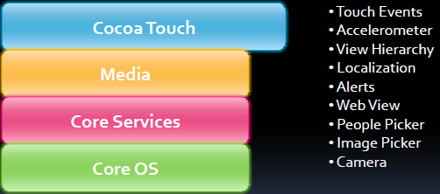
Cocoa Touch

Slide 14
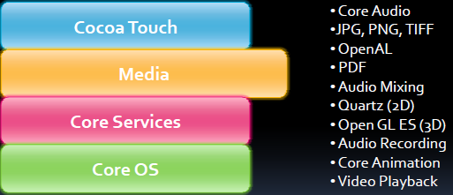
Media

Slide 15
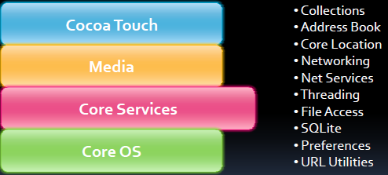
Core Services

Slide 16
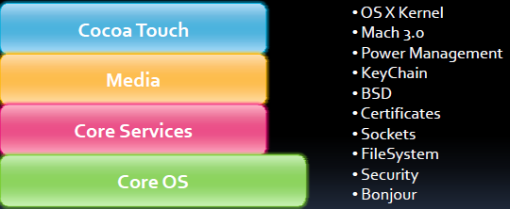
Core OS

Slide 17
Multitasking Myth
There is no truemulti-tasking on the iPhone OS
  Apples currently uses it only for their apps in a limited way
  There is no multi-tasking for third-party apps
  Keep that in mind when designing apps
    The home button is used to close application A
    Then the user clicks on the application B
    Finally goes back to application A
    All applications should save state to enhance user experience
However, there is multi-tasking on the iPhone OS
  Based off of Unix
  Can receive email while on a call
  Music can be playing in the background
  Apple disallowed third-party multi-tasking apps for performance reasons
http://www.roughlydrafted.com/2008/03/13/iphone-20-sdk-the-no-multitasking-myth/

Slide 18
Exercise
How to download an application from App store ?
What is unlocking, jailbreaking an iphone ?

Slide 19
References
http://developer.apple.com/

Slide 20
Question and answer
Thank you

